Slide 1
Neural Networks cont.
Keith Burghardt, Kristina Lerman
USC Information Sciences Institute
DSCI 552 – Spring 2021

Slide 2
Topics this week
Reminder:
Quiz 4 due Wednesday
Neural network models
Convolutional neural networks(CNN).
Batch normalization
Model architectures:
LeNet
AlexNet
VGG
ResNet
Symmetries and Invariance

Slide 3
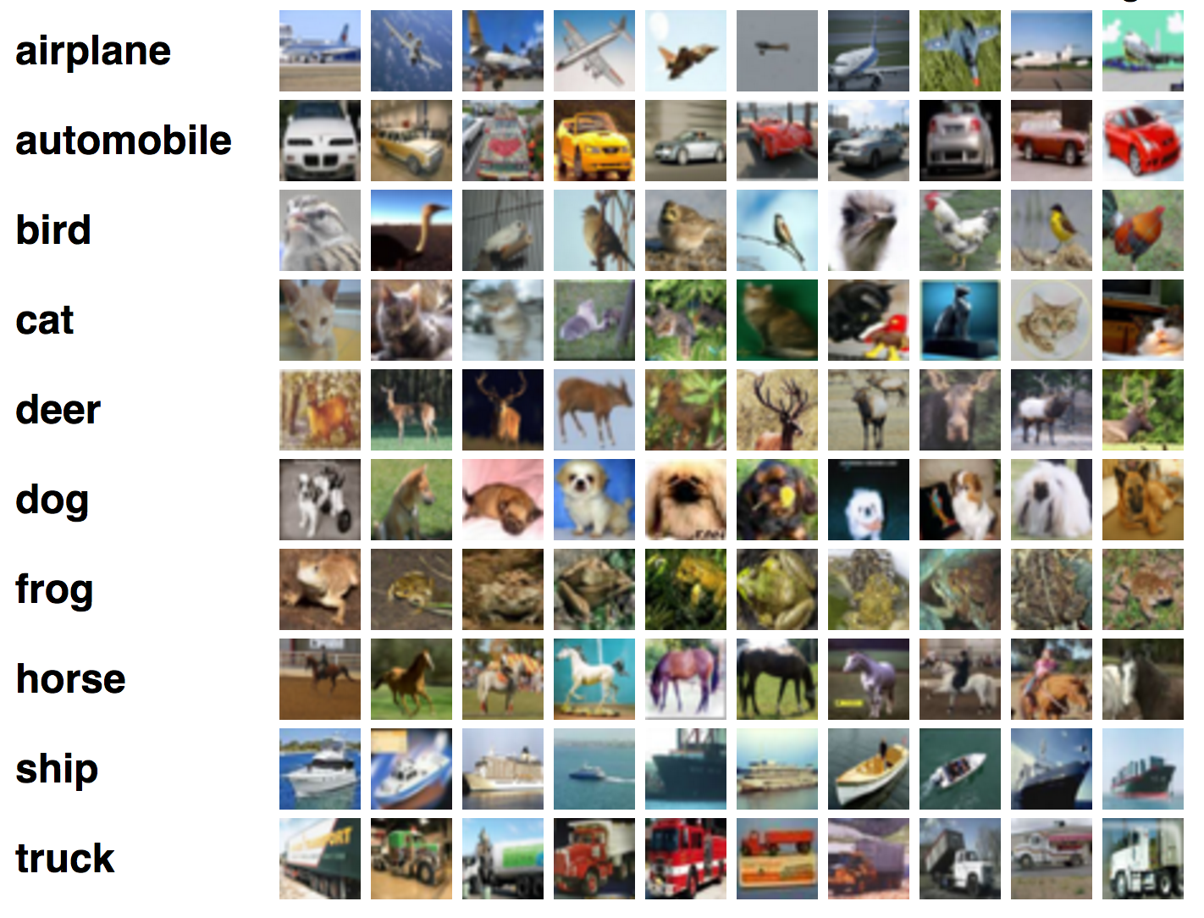
Reminder from last week
Computers like numbers
‘airplane’ -> 0
‘automobile’ -> 1
‘bird’ -> 2
…
Often our goal is to find these categories
Ex: A self-driving car must detect what is a tree, bush, or person

Slide 4
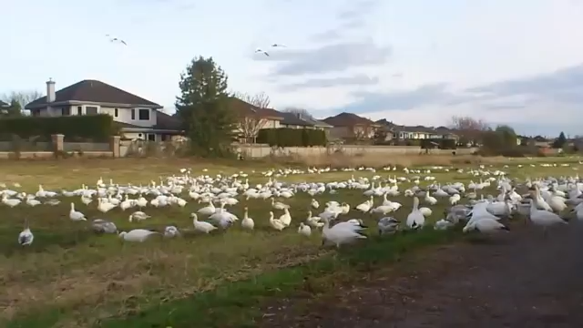
Human example

Slide 5

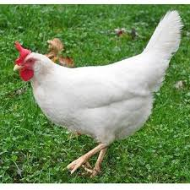
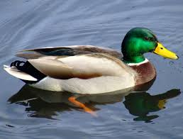
What is going on?
Kids use machine learning and don’t even know it!
??

Slide 6
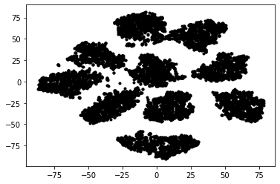
Reminder from last week
All-to-all feed forward networks work pretty well!
Accuracy: 97.5%
Can we do better?
Being wrong 2% of the time can be bad…
Ex: Let’s say 10000 checks cashed online a week
2% are flagged: 200/week need a human to check
This equates to angry customers and lots of person-hours!
Clusters of each number

Slide 7
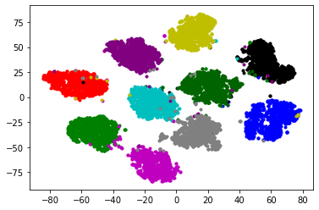
We can make it better! We have the technology…
Convolutional neural networks are one way we can do this
Accuracy: 98.8% (error cut in half)!
Intuition: each layer looks at how nearby neurons relate to each other
E.g., the ways pixels change define edges
The way edges change defined shapes
The way shapes relate defines labels
6
8
2
0
7
4
1
3
9
5

Slide 8
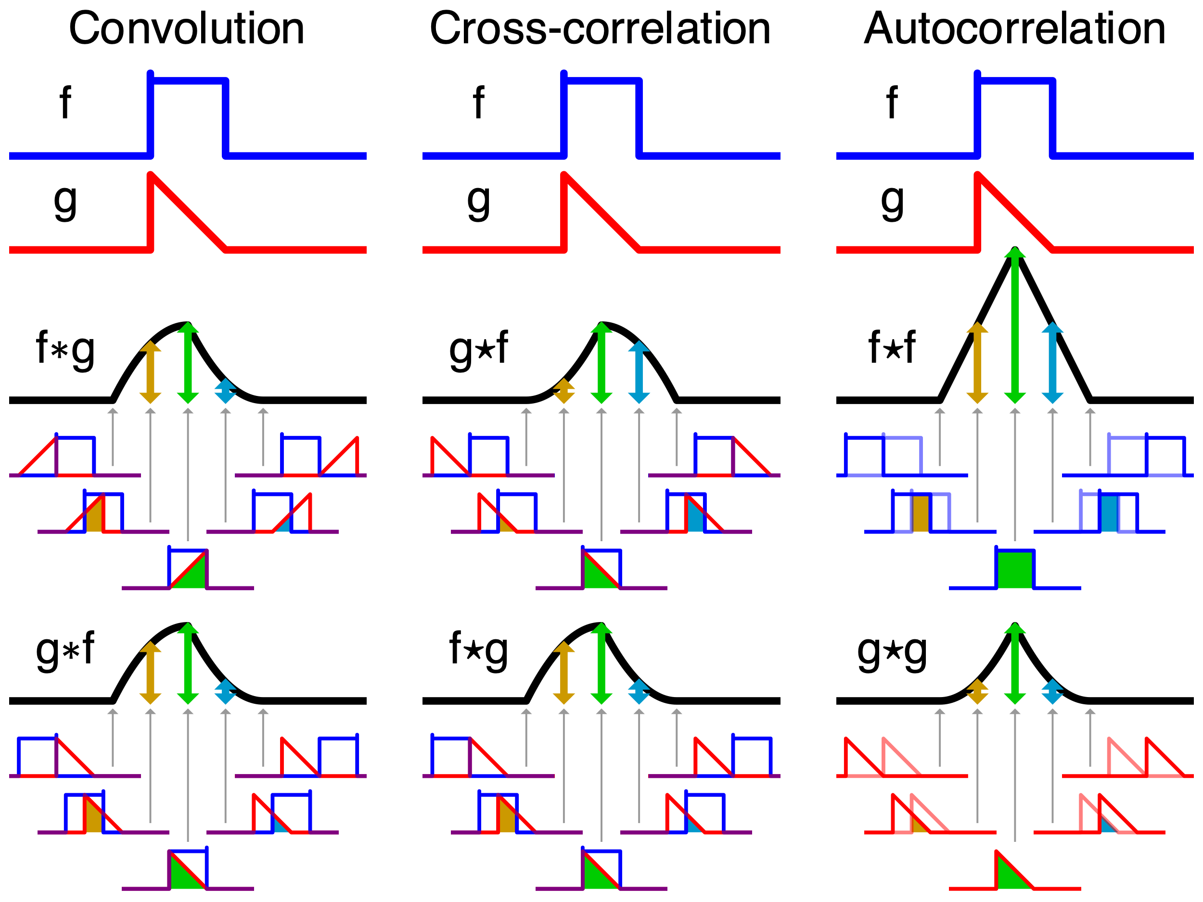
What is Convolution
Multiplying two functions “ontop” of each other (in a matrix, this is element-by-element)
https://en.wikipedia.org/wiki/Convolution

Slide 9

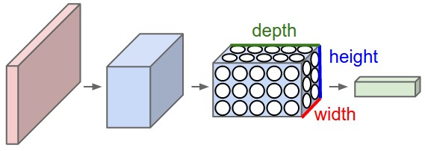
Convolution vs Dense Feed-Forward NNs
Regular Feed-forward NN
CNN aka ConvNet

Slide 10

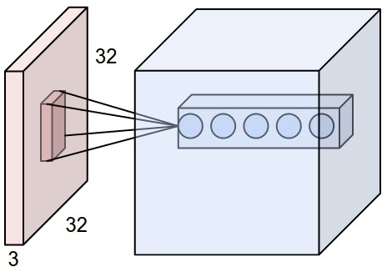
Convolution Feed-Forward NNs
Weights = “Filter”

Slide 11
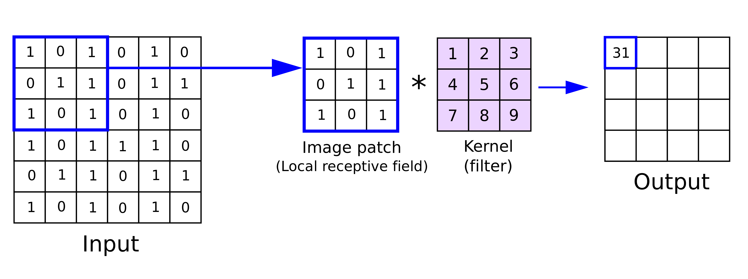
1*1 + 0*2 + 1*3 + 0*4 + 1*5 + 1*6 + 1*7 + 0*8 + 1*9
=
Multiply filter and patch
Sum
https://anhreynolds.com/blogs/cnn.html

Slide 12
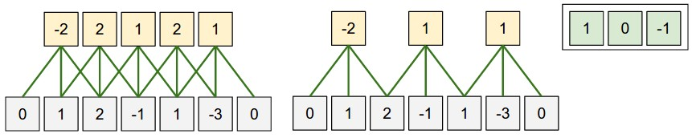
1 Dimension Example
(1D ConvNets are sometimes used in Natural Language Processing)
https://cs231n.github.io/convolutional-networks/

Slide 13

https://giphy.com/explore/convolutional-neural-network

Slide 14
Convolution Feed-Forward NNs
Several hyperparameters:
Filter: width and height
Number of filters
Padding and strides
Pooling layers: Sometimes (but now rarely) used to shrink layer’s “image”
Padding: adding pixels around image to allow the network to sweep to edge
No Padding: each layer gets smaller (edge gets clipped off)
Stride
How much you move the neural network
Stride of 1 = move over entire image (more thorough)
Stride > 1 = skip pixels (faster)

Slide 15

Pooling
Pooling
Max (max within set of values)
Mean (mean of values)
Stride: how many pixels you move in x/y
Example of max pooling with stride of 2 on left
https://en.wikipedia.org/wiki/Convolutional_neural_network

Slide 16
Example ConvNet
https://anhreynolds.com/blogs/cnn.html

Slide 17
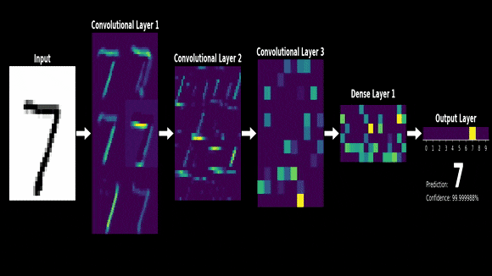
https://discuss.pytorch.org/t/how-can-i-print-the-image-of-each-layer-in-cnn/67597
https://discuss.pytorch.org/t/how-can-i-print-the-image-of-each-layer-in-cnn/67597

Slide 18

https://cs231n.github.io/convolutional-networks/

Slide 19
Application with jupyter notebook

Slide 20
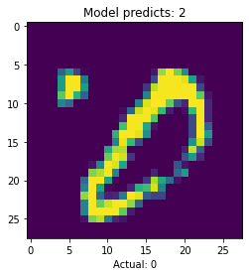
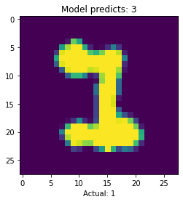
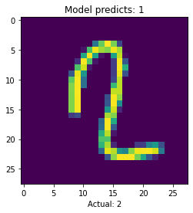
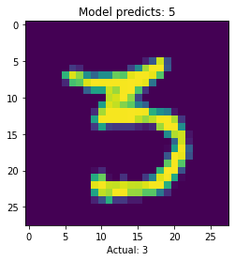
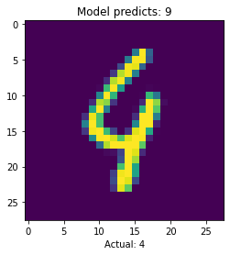
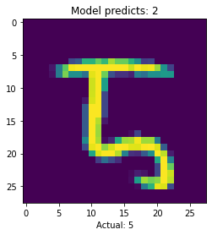
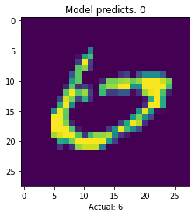
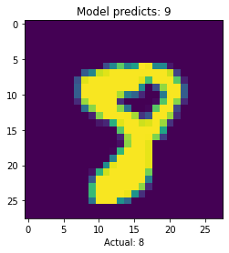
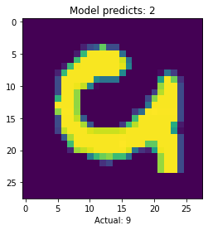
Where Might CNNs Fail?

Slide 21
Neural Networks Don’t Think Like Us
Where are neural networks making mistakes?
0: odd dot confuses NN
2: long vertical line may confuse it for a 1
8: lack of circle on bottom of “8” may confuse it for 9
Clearly, while neural networks can make guesses faster than us, it’s mistakes are revealing
If you’re interested in how neural networks “tick”, please explore explainable AI

Slide 22
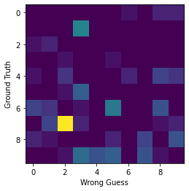
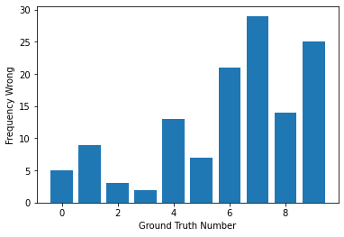
What numbers are mislabeled?

Slide 23
Making Sense of Black Box Neural Networks
Notice what numbers are “near” each other
Errors appear when the clusters overlap (9 and neighbors)
Most dissimilar numbers are far away
This gives us a clue about the high-dimensional decision boundary!
6
8
2
0
7
4
1
3
9
5

Slide 24
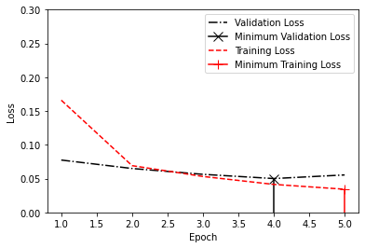
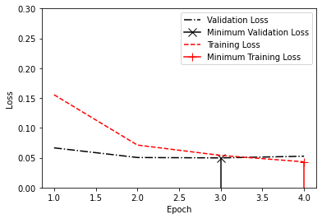
Batch normalization vs not
No batch normalization
Accuracy = 98.6%
With batch normalization
Accuracy = 98.4%
Batch normalization is also a little slower (60s/layer vs 50s/layer)
Clearly, all these methods are not universally better or worse
One limitation is somewhat small data, as well as small model (only applied to 1 Conv layer)
No Batch Normalization
With Batch Normalization

Slide 25
What numbers are mislabeled?
We notice “6”, “7”, and “9” are mislabeled most often
Why is that?
6 is confused for a 5
7 is often confused for a 2
9 is confused for several numbers (3, 4, 5, and 7)
While we have an intuitive, abstract, understanding of numbers, NNs do not
We can easily infer when a “3” looks like a 3, but when pixels are close enough to fill in circles (“3” -> “8”) then mistakes occur
Notice how bad labels can also confuse AI (“poisoning” the training data)

Slide 26
Training Neural Networks
2 options with NNs
Start with a pre-trained network (“warm start”)
Training on this is called “fine tuning”
Create your own (“cold start”)
Each has advantages
Cold start is needed if data is small (warm start network is trained to wrong data, and might need some data to work well)
Obviously, the SOTA networks used their own architecture, so with enough thought and data cold-start can beat any other network
Warm start gets you half-way there. If model was trained on similar data, extra fine-tuning may give you the best model

Slide 27
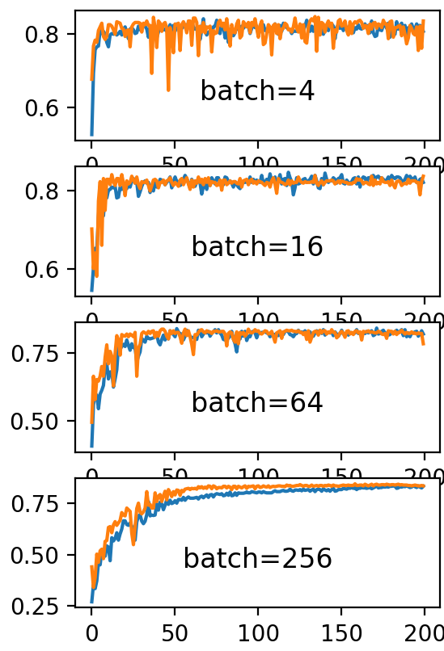
Training Neural Network
We use backpropagation to train them (all of this is in the background of Keras)
Mini-batch training:
Use 10-100 datapoints to determine how to change parameters via backpropagation
Each datapoint gets you some idea of what parameters to reduce, averaging the gradient (direction to reduce/increase parameters) is better than 1 datapoint
Alternative: look at all data
More accurate, but very slow (O(N) vs O(1) for N datapoints)
In practice, mini-batches are BETTER!
https://machinelearningmastery.com/how-to-control-the-speed-and-stability-of-training-neural-networks-with-gradient-descent-batch-size/

Slide 28
Batch Normalization
Add new layer (tf.keras.layers.BatchNormalization())
Each feature is now centered (mean = 0) and normalized (variance=1) within mini-batch
How is this helpful:
Reduces very large/small features (after activation -> 0 or 1 aka “saturation” = bad)
Effectively regularizes network (i.e., better generalizes network)
Can speed up training (increase learning rate, no dropout layers, etc.)
Therefore you now have 2 tools to add to any morel: batch normalization or dropout.
One or both will improve model with little extra effort

Slide 29
Architectures

Slide 30
Common Architectures
1989: LeNet
first time CNN was used
Inspired by “neocognitron” (looking at local features)
2012: AlexNet (game changer: top-5 accuracy = 15%, 10 points better than runner up!)
VGG
ResNet
Variational Autoencoders

Slide 31
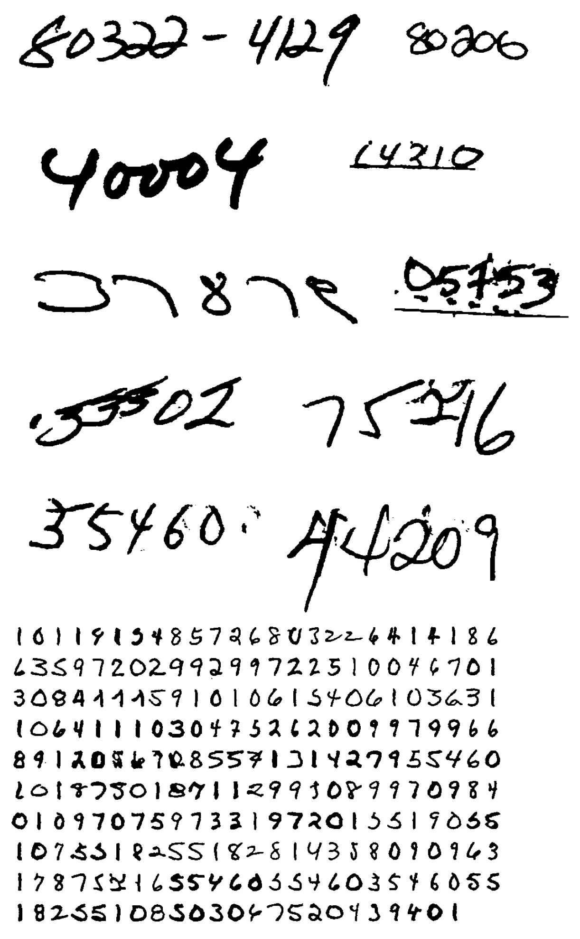
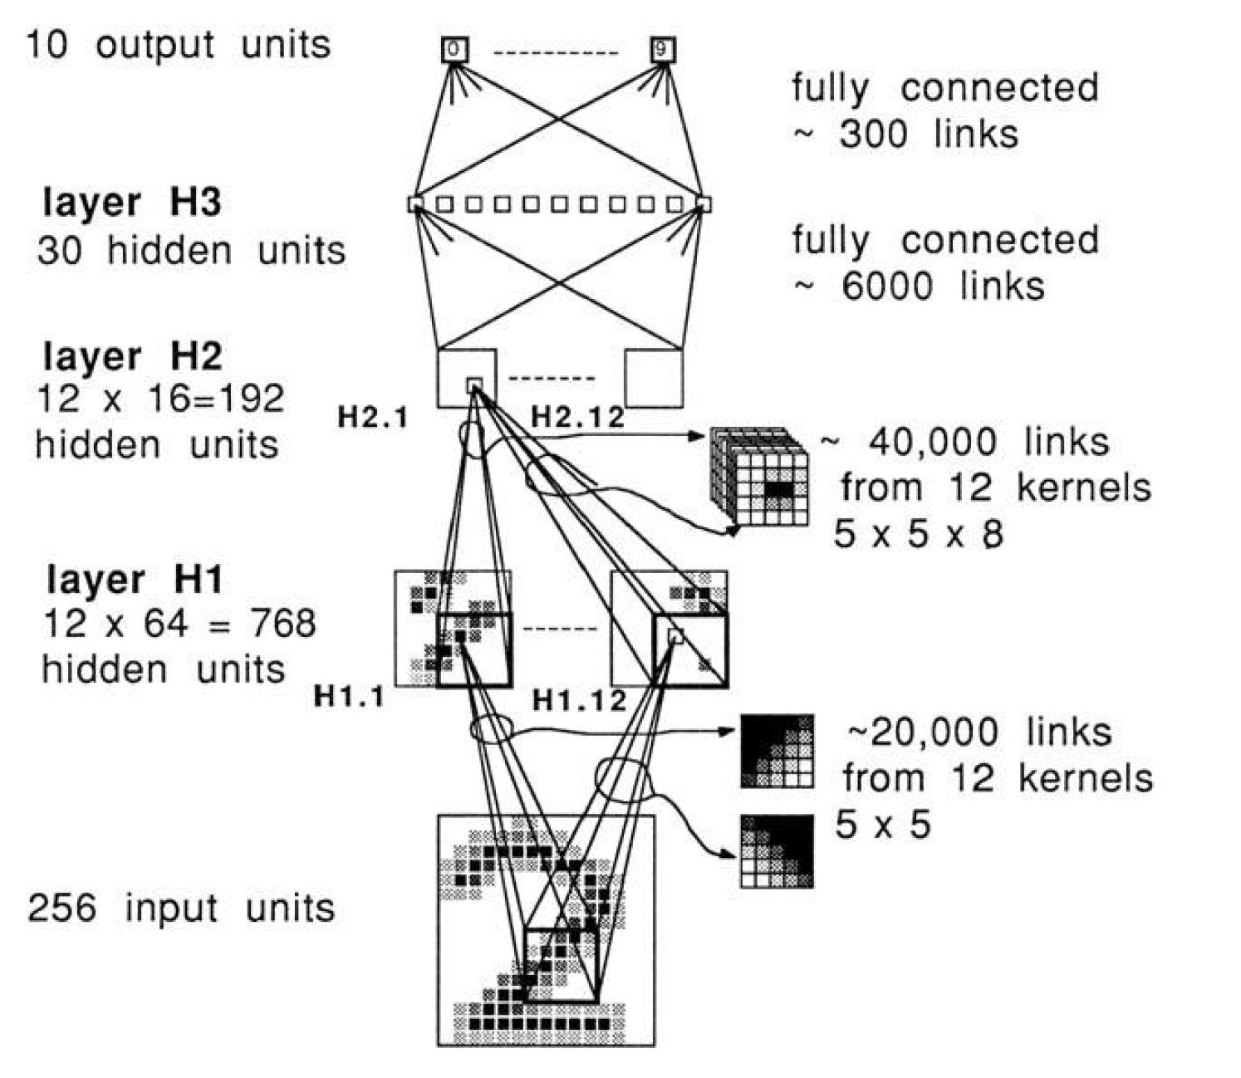
LeNet: Just a Regular ConvNet
LeCun et al., 1989
Activation function: Tanh

Slide 32
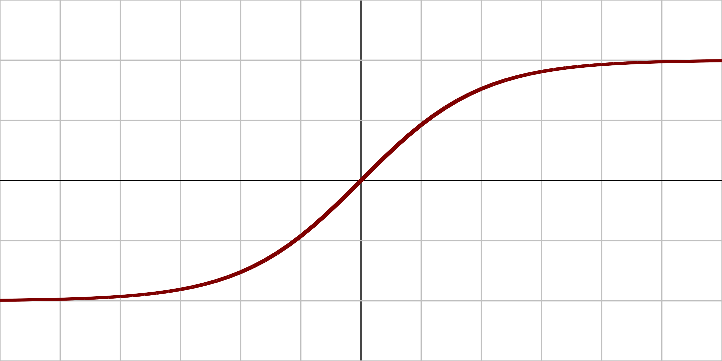
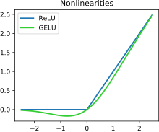
AlexNet
Benchmark: 15M data, 22,000 categories
Deeper GPU-based network
8 layers
Faster training
Activation function is ReLU (now the standard)
“Rectifier linear unit”
F(x) = x if x>0, else 0
Deep NNs with ReLU are proven to universally approximate continuous function
Old: Tanh
Current: ReLU (and similar)
https://en.wikipedia.org/wiki/Activation_function

Slide 33
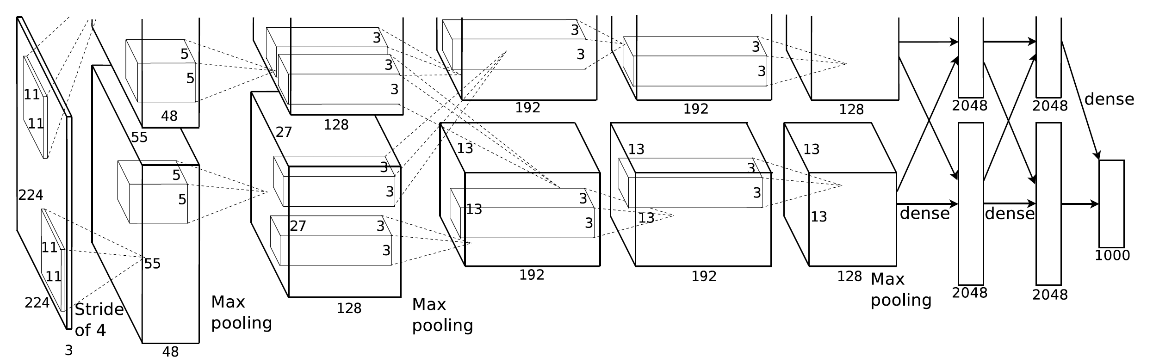
AlexNet
Training is split between GPUs with minimal communication at each layer
Final dense layer combines inputs for better accuracy

Slide 34

VGG16

Slide 35
VGG16
16 Convolution layers
Very slow to train!
Luckily we can use pre-trained models and fine tune

Slide 36
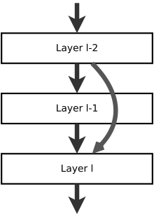
ResNet
“Residual neural network”
If layer I-2 and layer I have the same number of neurons, information is transformed/lost at layer I-1
This network allows features to propagate across layers
Avoids vanishing gradients
https://en.wikipedia.org/wiki/Residual_neural_network

Slide 37
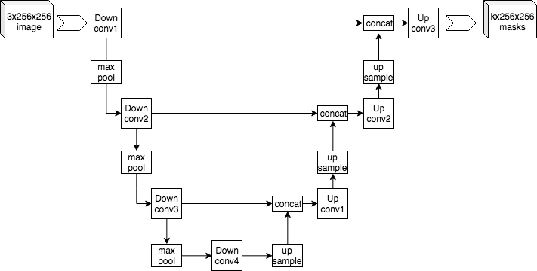
U-Net
Note the “U” shape
How to make these “jumps” on Keras
Layer(input)
Features propagate, like ResNet
Compressed information is here

Slide 38
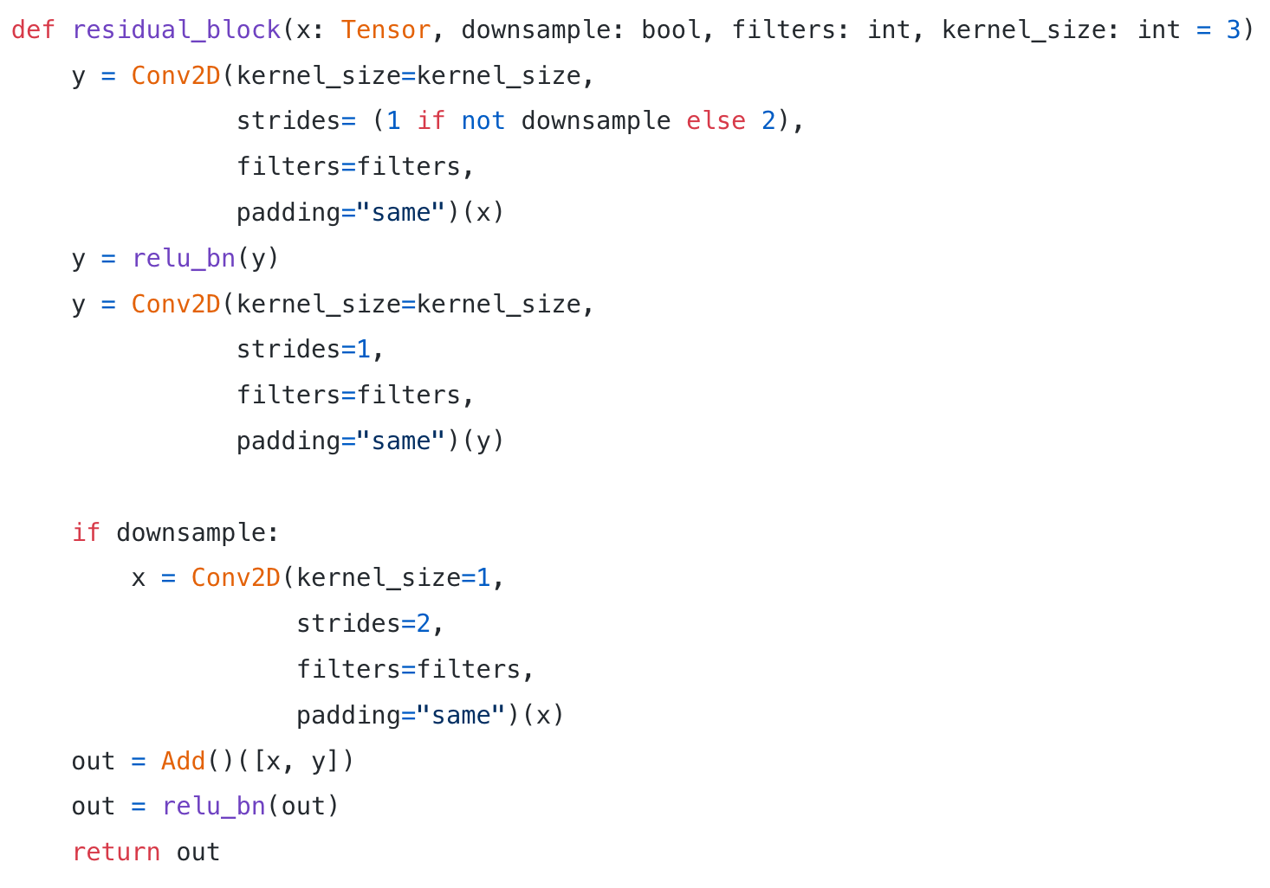
Code Example
https://towardsdatascience.com/building-a-resnet-in-keras-e8f1322a49ba

